Slide 1
2024 Drilling Prospects

Slide 2
Barnes Burner Prospect

Slide 3
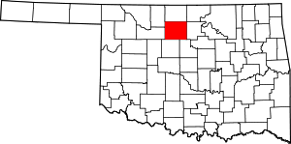
Location & History
The Barnes Burner prospect is located along the prolific Nemaha uplift, a major geological feature extending from southeast Nebraska to Oklahoma City responsible for numerous structural hydrocarbon traps. The North Barnes Field, where this prospect lies, was first discovered in 1926 and produced oil from the Wilcox formation until 1961, with additional development occurring during the 1940s, 1950s, and as recently as 1993.

Slide 4
Prospect Overview
Significant production history
Existing wellbore available
Unproduced gas zones
Potential inert gas
Multiple zones tested gas productive (500 - 2000 MCFPD) but not produced due to lack of sales line
Shallow zones indicate presence of nitrogen or other light gases like helium
Total field cumulative oil production of 594,020 BBLs from 11 wells
Key existing wellbore obtained for recompletion (produced 30,368 BBLs)
The Barnes Burner prospect offers a re-entry opportunity to test and produce from multiple gas zones with high flow rates, leveraging existing wellbore and reasonable access to a gas sales line.

Slide 5
Target Formations
Layton Sandstone
The Layton Sandstone was tested either by drill stem tests or production tests, with volumes ranging from 900 MCFPD to 2000 MCFPD. Volumetric analysis indicates 3.2 BCF of gas in place within this formation on structure.
Oswego Limestone
The Oswego Limestone was tested by drill stem and production tests with volumes ranging from 750 MCFPD to 1000 MCFPD. Volumetric calculations suggest 1.3 BCF of gas in place within the Oswego formation on structure.
Skinner Sandstone
The Skinner Sandstone was tested either by drill stem tests or production tests with volumes ranging from 500 MCFPD to 550 MCFPD. Volumetric calculations indicate 1 BCF of gas in place within the Skinner formation on structure.

Slide 6
Layton Sandstone
Reservoir Properties
Gas in Place
The Layton Sandstone has demonstrated excellent reservoir properties through production tests, with gas rates ranging from 900 MCFPD to 2000 MCFPD.
Volumetric analysis of the Layton Sandstone on structure indicates a significant gas reserve of 3.2 BCF (Billion Cubic Feet) in place.
Potential Target
Proven Production
The Layton Sandstone represents a prime target formation for potential gas production within the Barnes Burner Prospect.
Several wells in the area have successfully tested and produced gas from the Layton Sandstone, confirming its production potential.

Slide 7
Oswego Limestone
Tested Rates
Estimated Gas Reserves
Drill stem and production tests revealed gas flow rates between 750 MCFPD to 1000 MCFPD from the Oswego Limestone.
Volumetric calculations based on the mapped structure indicate approximately 1.3 BCF of gas reserves in place within the Oswego Limestone.
Reservoir Quality
Development Potential
The Oswego Limestone is a known productive reservoir with favorable porosity and permeability characteristics in the prospect area.
With the estimated reserves and demonstrated flow rates, the Oswego Limestone represents a viable target for development as part of a multi-zone completion strategy.

Slide 8
Skinner Sandstone
Well Test Results
Estimated Gas Reserves
Wells drilled in the Skinner Sandstone formation have been production tested, yielding flow rates between 500 MCFPD (thousand cubic feet per day) to 550 MCFPD.
Based on volumetric calculations and structural mapping, the estimated gas reserves in place within the Skinner Sandstone formation are approximately 1 BCF (billion cubic feet).
Formation Overview
Development Potential
The Skinner Sandstone is a prolific gas-bearing formation that lies within the target area of the Barnes Burner prospect, presenting an attractive opportunity for gas production.
With the promising well test results and substantial estimated reserves, the Skinner Sandstone formation represents a compelling target for further development and production within the Barnes Burner prospect area.

Slide 9
AFE and Economic Analysis
Prospect Details
Value
Total Investment
$678960.00
Estimated Oil Reserves
NA
Estimated Gas Reserves
2,600,000 MCF
Estimated Total Net Revenue
$2630784.00
ROI
287%

Slide 10
Path Forward
Complete Pooling and Assign Leasehold
Finalize regulatory requirements, pool the 160-acre drilling unit, and assign the leasehold.
Recomplete Existing Wellbore
Recomplete the Gerken 34-1 wellbore by perforating casing, installing tubing, repairing surface facilities and lay gas line to put the well on production.
Production and Revenue Generation
Initiate production from the recompleted well, generating revenue from the sale of natural gas and any associated liquids.
Upside Potential from Additional Drilling Locations
Evaluate the potential for drilling additional wells to exploit the multiple stacked pay zones identified within the prospect area.

Slide 11
Cogswell Prospect

Slide 12
An opportunity to capitalize on a multi-zone prospect along the Nemaha Uplift with structural and stratigraphic trapping mechanisms.

Slide 13
Overview
Prospect Location
Nemaha Uplift
The prospect is situated 4 miles northeast of Breckenridge, Oklahoma.
A major regional paleostructure extending from Nebraska to Oklahoma City, trapping hydrocarbons from Ordovician formations to as shallow as 800 feet.
The prospect's location along the Nemaha uplift presents promising hydrocarbon trapping opportunities across multiple formations.

Slide 14
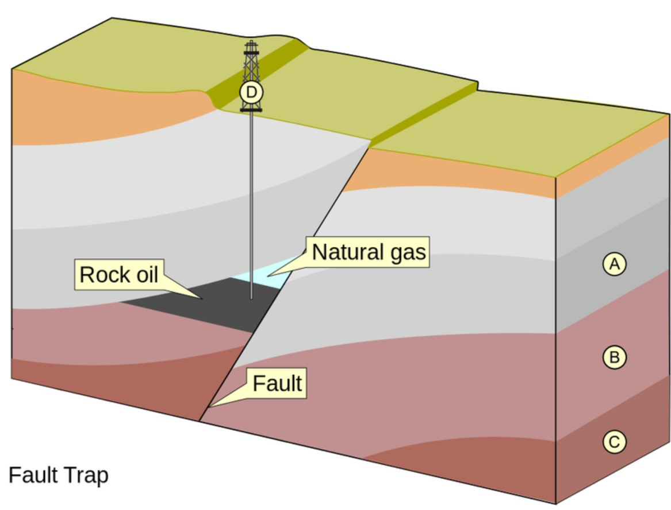
Primary Target
The 2nd Wilcox Sand formation lies at a depth of approximately 6,000 feet and is characterized by high-quality reservoir rocks with favorable structural trapping mechanisms. Previous wells in the area have produced from shallower formations, but the 2nd Wilcox Sand remains largely untapped, presenting an exciting opportunity for potential hydrocarbon production.

Slide 15
Secondary Targets
Arbuckle Zone
Known productive reservoir in high structural positions against faults in the region, but untested in the immediate prospect area.
Marshall Zone
Also a productive reservoir along faults in the region, but not yet produced from within the prospect AMI (Area of Mutual Interest).

Slide 16
Layton Sands
Regional Production History
Reservoir Intervals Identified
The Layton sands have proven to be regionally productive in structural and stratigraphic traps, demonstrating the potential for hydrocarbon accumulations.
Interpretation of well logs and subsurface mapping indicates the presence of two potentially productive Layton sand intervals within the Cogswell Prospect area.
Structural Trapping Mechanism
Exploitable Reservoir Thickness
Structural mapping reveals closure against the main fault system, providing a favorable trapping mechanism for potential hydrocarbon accumulations within the Layton sands.
The Lower Layton sand interval exhibits a thickness of up to 27 feet, with the upper Layton containing around 100 feet, offering a substantial reservoir section for potential development.

Slide 17
Regional Activity

Slide 18
AFE and Economic Analysis
Prospect Details
Value
Total Investment
$1,259,450.00
Estimated Oil Reserves
180,000 Bbls
Estimated Gas Reserves
200,000 MCF
Estimated Total Net Revenue
$5,666,304.00
ROI
350%

Slide 19
Eskridge Prospect

Slide 20
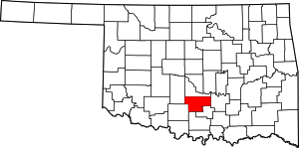
Location and Size
Acreage
Location
The initial prospect covers 160 acres in the SW/4 section of 19 Township 4N Range 2W.
Located approximately 3 miles from the town of Maysville in Garvin County, Ok.
The Eskridge prospect is strategically located near Maysville with a compact yet promising initial acreage for exploration.

Slide 21
Primary Target - Oil Creek Sandstone
2.9 BCF
Existing well produced 2.9 BCF gas from Oil Creek sandstone before being plugged due to downhole failure
50,000 BBL
Estimated remaining oil reserves in Oil Creek sandstone
3,000,000 MCF
Primary Target
Estimated remaining gas reserves in Oil Creek sandstone
Oil Creek sandstone is the primary drilling target

Slide 22
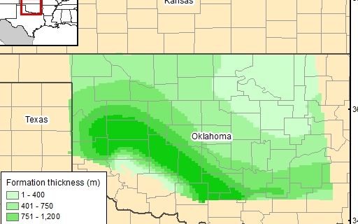
Additional Target - Arbuckle Formation
Arbuckle Formation Map
Nearby Productive Arbuckle Wells
A map showing the extent and depth of the Arbuckle formation within the prospect area.
This map shows wells that have produced from the Arbuckle formation in the immediate vicinity.

Slide 23
AFE and Economic Analysis
Prospect Details
Value
Total Investment
$1,616,100
Estimated Oil Reserves
50,000 Bbls
Estimated Gas Reserves
3,000,000 MCF
Estimated Total Net Revenue
$6,374,592
ROI
294%

Slide 24
Return on Investment
Exceptional Return Potential
The proposed drilling project offers an exceptional return on investment of up to 294%, showcasing its lucrative potential for investors.
Estimated Net Revenue Range
Based on projected production rates, the estimated total net revenue would be around $6.374 million, allowing for substantial financial gains.
Low Risk, High Reward Opportunity
With a relatively modest total cost of $1.616 million and the prospect's strong production history, this project presents a low-risk opportunity with substantial upside potential.

